Slide 1
22CS014
Front End Engineering
Submitted by:
Dhruv Kinger - 2210990275
Divyanjali Singla - 2210990296
Augustya – 2210990196
Nikhil- 2210990608
Submitted to:
Vikas
Department of Computer Science and Engineering
Chitkara University, Punjab

Slide 2
Fitness Hub

Slide 3
INTRODUCTION
We have created a project on Fitness Website
A Fitness Challenges App that fetches data from user and displays results accordingly. We have created this website using HTML,CSS, Javascript.

Slide 4
PROBLEM STATEMENT: • Create an app that allows users to join fitness challenges, log workouts, and compete with others for goals and achievements.
SOLUTION
We create a successful website on FITNESS CHALLENGES using HTML,CSS, JAVASCRIPT so on....

Slide 5
FEATURES
Intuitive Design
Feedback Mechanisms
Integration Readiness
Supportive

Slide 6
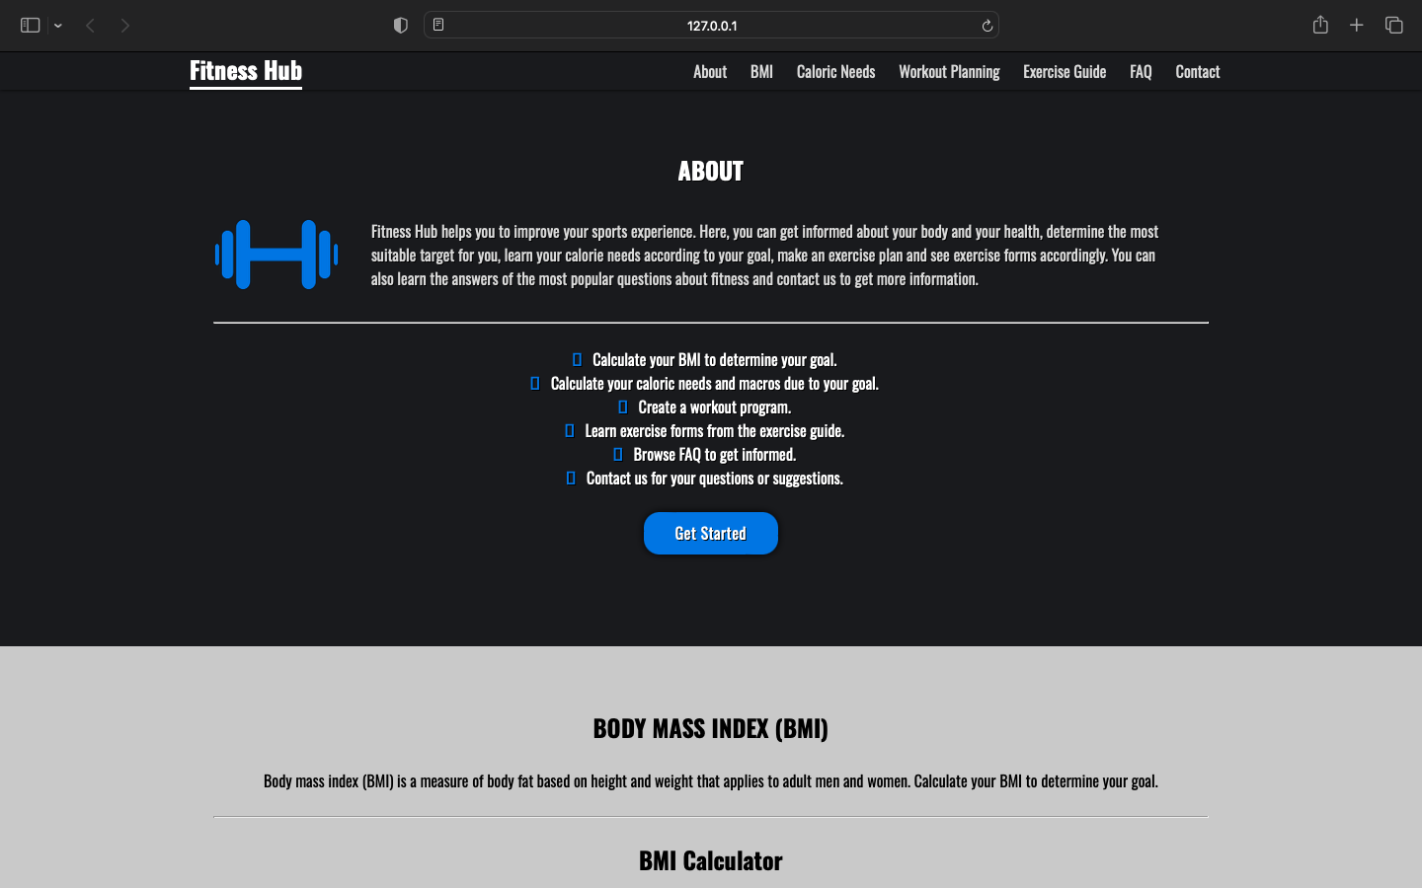
The is the main screen for Fitness Hub

Slide 7
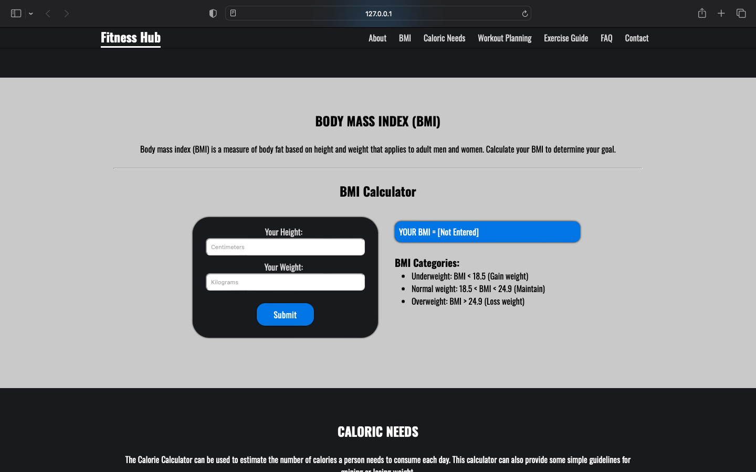
There is a BMI calculator used to calculate Body Mass Index.

Slide 8
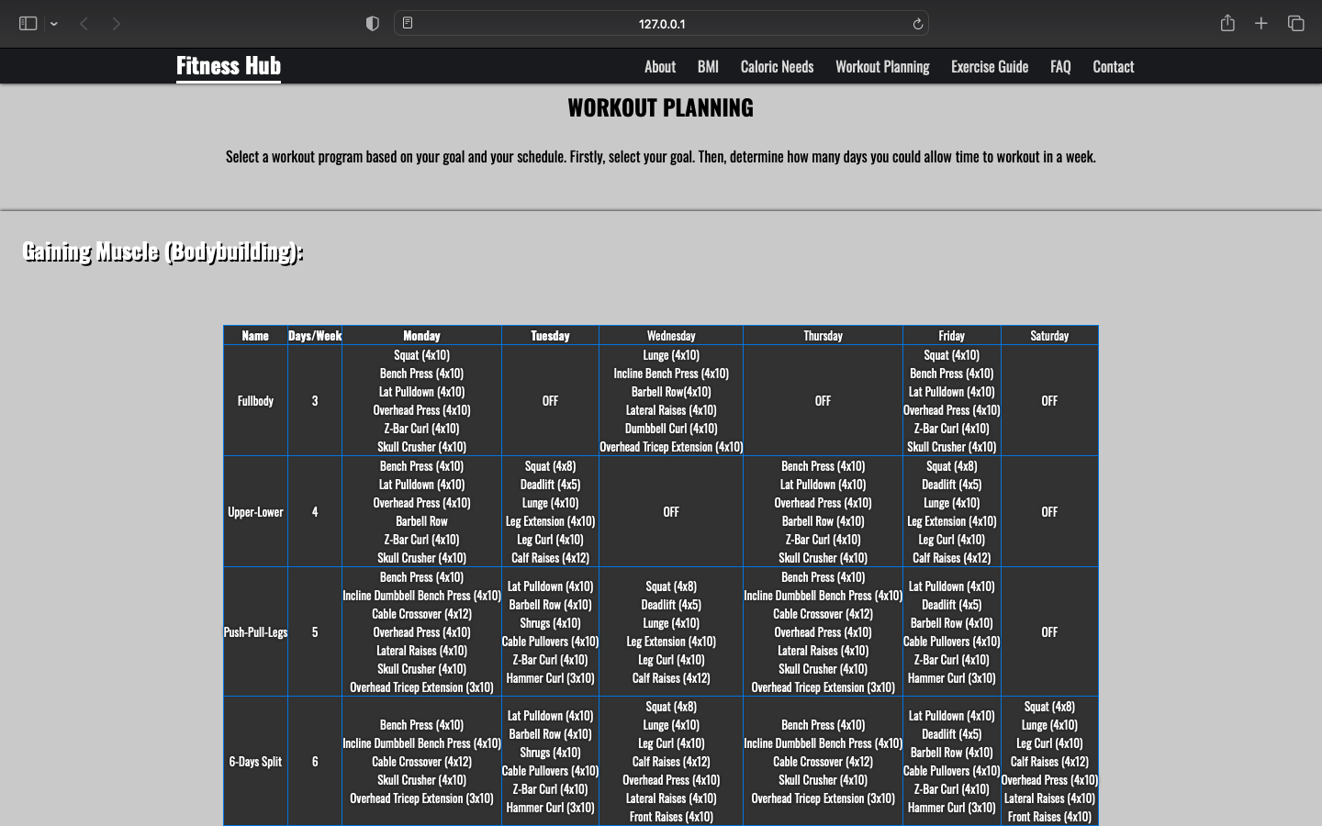
There is a working planner which is used to plan the workout routine , exercises , diet etc.

Slide 9
ADVANTAGES
Personalization Options
Visual Feedback
Accessibility Features
Performance Optimization
Accuracy of data.

Slide 10
Thank You

